Slide 1
Comparing Groups with t tests and ANOVA
RX 319
Introduction to Healthcare Analytics

Slide 2
Learning Objectives
Explain the goal of a 2-sample t test.
Describe when a paired t test should be used.
Explain when an ANOVA might be used.
Compare and contrast t tests and ANOVA.
2

Slide 3
Example – Comparing Soporific (sleep-inducing) Drugs
Patient ID | Treatment | Extra Sleep (hr)
1 | A | -1.2
2 | A | -0.1
3 | A | 3.4
… | … | …
11 | B | 1.6
12 | B | 4.6
13 | B | 3.4
… | … | …
20 patients were randomly divided to two groups (Drug A & B)
All patients were given placebo on one night & drug on another
Difference in sleep on the two nights is “Extra Sleep”
Does one drug perform better?
3
AR Cushny, AR Peebles. J Physiol. 1905 Jul 13; 32(5-6): 501–510.

Slide 4
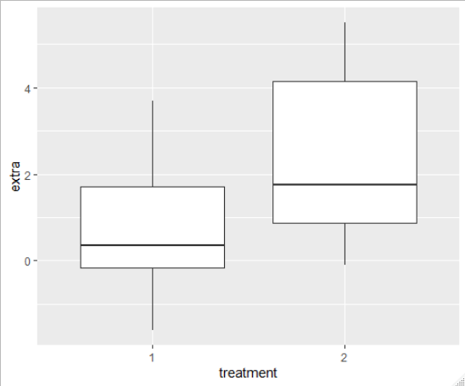
Comparing two distributions with a t test
How much extra sleep did they get after treatment?
Visualizations let you see a difference
Statistical tests can help you quantify a difference
Student’s t test: Do we think this is a real difference or just random chance?
More technical definition: How confident are we that these 2 sample groups came from 2 different distributions with different averages?
Insomnia patients were treated with 2 different drugs
4
AR Cushny, AR Peebles. J Physiol. 1905 Jul 13; 32(5-6): 501–510.

Slide 5
A simple t test
2 ways to do it in R
t.test(vector1, vector2) t.test(numbers ~ groups, data = df)
Result:
Welch Two Sample t-test
data: group1 and group2
t = -1.8608, df = 17.776, p-value = 0.07939
alternative hypothesis: true difference in means is not equal to 0
95 percent confidence interval:
-3.3654832 0.2054832
sample estimates:
mean of x mean of y
0.75 2.33
5

Slide 6
2-Sample vs. Paired t tests
2-Sample t test
t.test(vector1, vector2)
Paired t test
t.test(vector1, vector2, paired = TRUE)
Patient ID | Treatment | Extra Sleep (hr)
1 | A | -1.2
2 | A | -0.1
3 | A | 3.4
4 | A | 3.7
5 | A | 0.8
6 | B | 1.6
7 | B | 4.6
8 | B | 3.4
Patient ID | Treatment | Extra Sleep (hr)
1 | A | 0.7
2 | A | -1.6
3 | A | -0.2
1 | B | 1.9
2 | B | 0.8
3 | B | 1.1
Does not need to be balanced
6

Slide 7
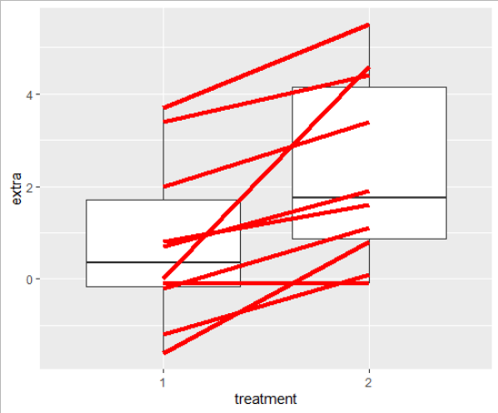
Why is that important?
Paired analysis (when relevant) can give you better “power” to detect differences
Unpaired Analysis
p = 0.08
Paired Analysis
p = 0.003
7

Slide 8
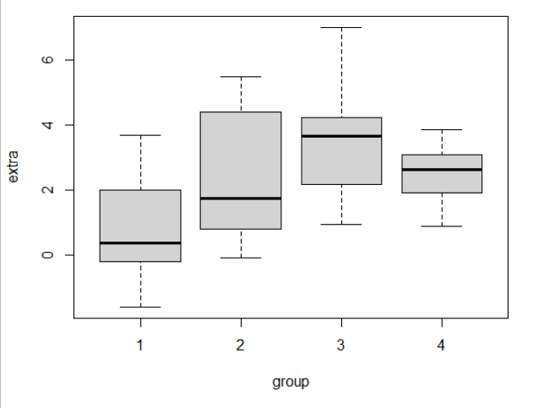
ANOVA (Analysis of Variance)
aov(extra ~ group, data = df)
Tells you if there may be differences among multiple groups
Does not say which groups are different (can draw boxplot, or run t tests between groups)
8

